Slide 1

Boot Camp for C Programming
Topic : Conditional Statements and Loops
Presented by-
Rupal Gondane
Nidhi Waghmare
Rutuja Sontakke
Prajakta Shegaonkar

Slide 2
IF ELSE Statement
The if-else statement in C is used to perform the operations based on some specific condition.
The operations specified in if block are executed if and only if the given condition is true.
It gives our program the ability to make decisions according to the input provided by the user.
There are the following variants of if statement in C language –
If statement
If-else statement
If else-if ladder
Nested if

Slide 3
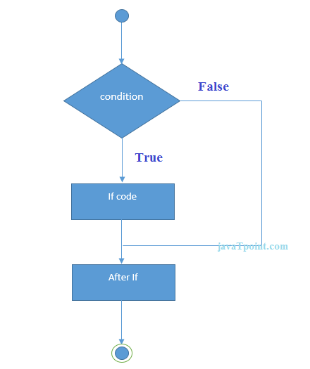
if Statement -
Use the if statement is to specify a block of C code to be executed if a condition is true.
Syntax-
if (test expression)
{
// code
}

Slide 4
Example:
#include<stdio.h>
int main(){
int i = 0;
printf("Enter a number:");
scanf("%d",&i);
if(i%2 == 0){
printf("%d is even number", i);
}
return 0;
}

Slide 5
if - else Statement -
Use the else statement to specify a block of code to be executed if the condition is false.
Syntax –
if (condition) {
// block of code to be executed if the condition is true
}
else {
// block of code to be executed if the condition is false
}

Slide 6
Example:
#include<stdio.h>
int main(){
int i = 0;
printf("enter a number:");
scanf("%d",&i);
if(i%2 == 0){
printf("%d is even number", i);
}
else{
printf("%d is odd number", i);
}
return 0;
}

Slide 7
if-else-if Ladder -
The if-else-if ladder statement is an extension to the if-else statement.
It is used in the scenario where there are multiple cases to be performed for different conditions.
Syntax -
if(condition1){
//code to be executed if condition1 is true
}
else if(condition2){
//code to be executed if condition2 is true
}
...
else{
//code to be executed if all the conditions are false
}

Slide 8
#include<stdio.h>
int main(){
int i = 0;
printf("enter a number:");
scanf("%d",&i);
if(i == 10){
printf("number is equals to 10");
}
else if(i == 50){
Example: printf("number is equal to 50");
}
else if(i == 100){
printf("number is equal to 100");
}
else{
printf("number is not equal to 10, 50 or 100");
}
return 0;
}

Slide 9
Nested – if Statement -
A nested if in C is an if statement that is the target of another if statement. Nested if statements mean an if statement inside another if statement.
It allows you to test multiple criteria based on the given input.
Syntax –
if (condition1)
{
// Executes when condition1 is true
if (condition2)
{
// Executes when condition2 is true
}
}

Slide 10
#include <stdio.h>
int main()
{
int i = 10;
if (i == 10) {
// First if statement
if (i < 15)
printf("i is smaller than 15\n");
Example: // Nested - if statement
// Will only be executed if statement above
// is true
if (i < 12)
printf("i is smaller than 12 too\n");
else
printf("i is greater than 15");
}
return 0;
}

Slide 11
Problems for practice –
Write a program in C to allow for ride in roller coaster but the condition is that the person's age should be 18 or more than 18. use if-else statement.
Develop an application for the following details
if the temperature is greater than -273, print the message- invalid temperature
if the temperature is -273, print the message- absolute 0 temperature
if the temperature is between -273 to 0, print the message- below freezing point
if the temperature is 0, print the message- at freezing point
if the temperature is between 0 and 100, print the message- normal temperature
if the temperature is 100, print the message- at boiling point
if the temperature is greater than 100, print the message- above boiling point
Write a program in C to take year as input from the user and identify whether the entered year is leap year or not.

Slide 12
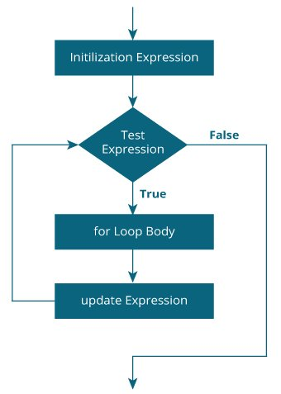
FOR LOOP :-
The for loop is used to execute a set of statements repeatedly until a particular condition is satisfied. We can say it is an open ended loop.
Syntax :-
for(initialization ; condition ; increment/decrement) {
statement-block;
}

Slide 13
The “for loop” is executed as follows :-
First execute a initialization statement.
Then it checks the condition expression. If it is true, the body of the loop is executed. If it is false, the body of the loop does not execute.
Then it evaluate the increment/decrement condition.
The condition is now evaluated again. If it is true, the loop executes and the process repeats itself (body of loop, then increment step, and then again condition). After the condition becomes false, the 'for' loop terminates.

Slide 14
Example :-
Que - Write a program to print the values of a 1 to 10 .
#include <stdio.h>
int main ()
{
/* for loop execution */
for(int a = 1 ; a <=10 ; a++){
printf("value of a: %d\n", a);
}
return 0;
}

Slide 15
Problem for practice :-
Que1 – Write a program to print the even numbers from 1 to 20 .
Que2 – Write a program to print your name 10 times.
Que3 – Write a program to print the odd numbers from 1 to 20

Slide 16

Introduction to
to
While loop &
Do-While loop
ile loop

Slide 17
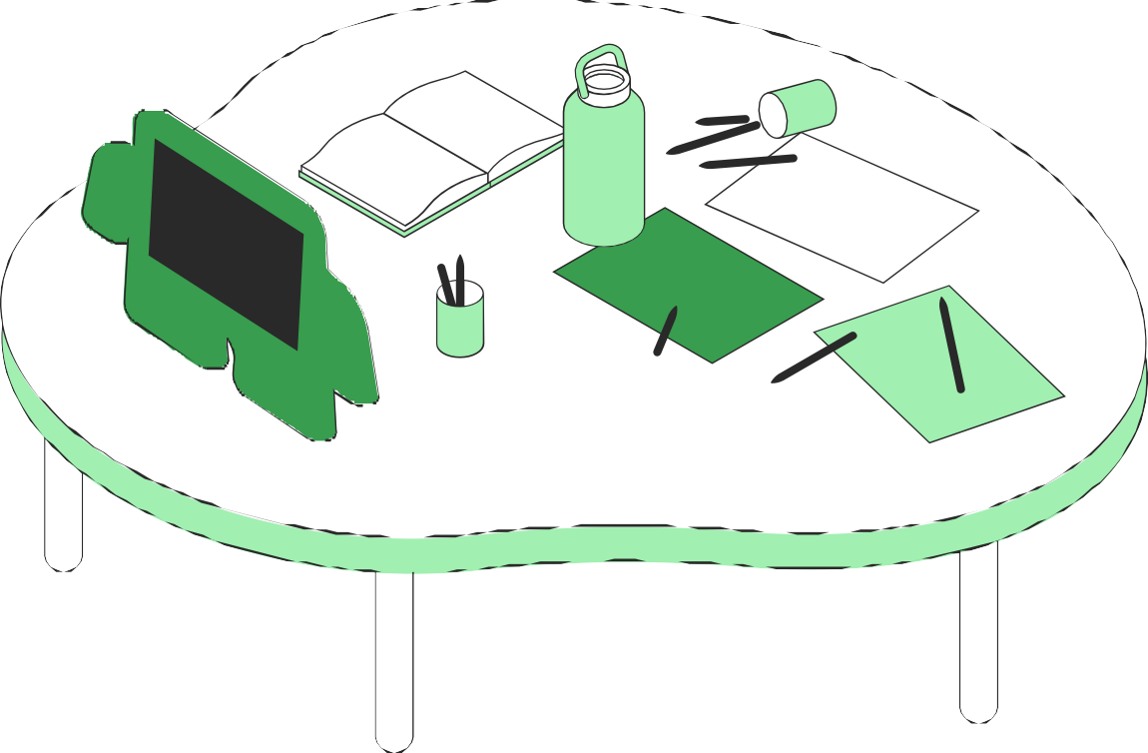
Defination:
A while loop in C programming repeatedly execute a target statement as long as a given condition is true.
While-loop
Syntax:
//Initilaizing variable
while (test Expression) {
// the body of the loop
}

Slide 18
EXAMPLE:
//Write a program Print numbers from 1 to 5
#include <stdio.h>
int main()
{
int i = 1; //initializing the variable
while (i <= 5) //while loop with condition
{
printf("%d\n", i);
++i;
}
return 0;
}

Slide 19

DO-While loop
Defination:
The body of do...while loop is executed at least once. Only then, the test expression is evaluated.
Syntax
do {
// the body of the loop
}
while (test Expression);

Slide 20

EXAMPLE:
Write a program to print table of 2
#include<stdio.h>
int main()
{
int num=1; //initializing the variable
do //do-while loop
{
printf("%d\n",2*num);
num++; //incrementing operation
}while(num<=10);
return 0;
}

Slide 21
While loop
Do-While loop
While loop
Loop is Entry control-loop.
While loop is a pre-test loop.
It test the condition before executing the loop body.
There is no semicolom at the end of the loop.
Do-while loop is exit control loop.
Do-while loop is a post test loop.
It test the condition at the end of the loop body.
Semicolom is compulrsory at the end of the loop.

Slide 22
Problem For Practice :
QUE 1: Program to print table for the given number using while loop in C.
QUE 2: Program to print first 5 odd number using while loop in C.
QUE 3: Program to print table of 2 using do- while loop in C.

Slide 23
Break Statement
The break is a keyword in C which is used to bring the program control out of the loop.
The break statement terminates the execution of the nearest enclosing do, for, switch, or while statement in which it appears.
Break statement can be used with
Loops
Switch case expressions

Slide 24
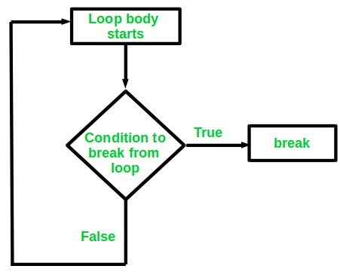
Syntax-
for (init; testExpression; update){
//codes
if (condition to break){
break;
}
//codes
}

Slide 25
Example:
#include <stdio.h>
int main(){
//add non zero numbers
int num;
int sum=0;
int i,n;
printf(" Enter how many number do you want to add \n");
scanf("%d", &n);
for (i=1; i<=n; i++) {
printf("enter number : %d\n", i);
scanf("%d", &num);
if (num==0) {
break;
} //if you enter zero, loop is terminated
sum = sum+num;
}
printf("Total is : %d\n", sum);
return 0;
}

Slide 26
Continue Statement
It is used to bring the program control to the next iteration of the loop.
The continue statement skips some code inside the loops and continues with the next iteration.
It is mainly used for a condition so that we can skip some lines of code for a particular condition.

Slide 27
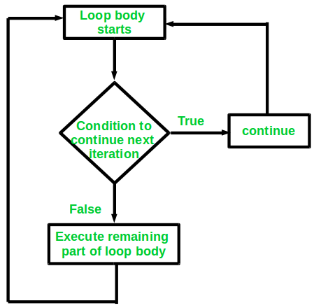
Syntax-
for (init; testExpression; update){
//codes
if (testExpression){
continue;
}
//codes
}

Slide 28
Example:
#include <stdio.h>
int main(){
// It takes input as positive, negative and zero number.
int num;
int sum=0;
int i,n;
printf("Enter how many number do you want to add\n");
scanf("%d", &n);
for (i=1; i<=n; i++) {
printf("enter number : %d\n", i);
scanf("%d", &num);
if (num==0) {
continue;
}
sum = sum+num;
}
printf("Total is : %d\n", sum);
return 0;
}

Slide 29
Switch Statement
This is how it works:
The switch expression is evaluated once.
The value of the expression is compared with the values of each case, if there is a match, the associated block of code is executed.
The break statement breaks out of the switch block and stops the execution.
The default statement is optional, and specifies some code to run if there is no case match.

Slide 30
Syntax-
Switch(expression)
{
case value1:
statement_1;
break;
case value2:
statement_2;
break;
..... ...... ......
case value_n:
statement_n;
break;
default:
default statement;
}

Slide 31
Example:
#include <stdio.h>
int main()
{
int day;
printf("Please, input a number for a day of the week!\n");
scanf("%d", &day);
switch(day)
{
case 1:
printf("Monday");
break;
case 2:
printf("Tuesday");
break;
case 3:
printf("Wednesday");
break;

Slide 32
case 4:
printf("Thursday");
break;
case 5:
printf("Friday");
break;
case 6:
printf("Saturday");
break;
case 7:
printf("Weekend");
break;
default:
printf("There is no such day in the week");
}
return 0;
}

Slide 33
Problems for practice:
1. Construct a program to print numbers in reverse order but it skips the multiple of two.
2. Write a program for switch case to perform the following condition,
a)Addition
b)Subtraction
c)Division
3. Construct a program which represent Magic 8-Ball using Switch case.

Slide 34
THANK YOU!

